Slide 1
From clouds to cores to envelopes to disks a multi-scale view of magnetized star formation
Chat Hull
University of California, Berkeley
Radio Astronomy Laboratory
10 July 2013
Colloquium
University of Illinois at Urbana-Champaign
Urbana, Ill.
Notes:
Star formation regions

Slide 2
Outline
Magnetized star formation
B-fields vs. outflows: multi-scale comparisons
Outflows/jets/disks and B-fields are randomly aligned
TADPOL survey
CARMA 1mm full-Stokes polarization system
TADPOL results
B-fields: multi-scale comparisons
Cloud → core → envelope → disk

Slide 3
Scales of star formation
> 1 pc
0.1 pc
1000 AU
< 100 AU
cloud
core
envelope
disk

Slide 4
Outline
Magnetized star formation
B-fields vs. outflows: multi-scale comparisons
Outflows/jets/disks and B-fields are randomly aligned
TADPOL survey
CARMA 1mm full-Stokes polarization system
TADPOL results
B-fields: multi-scale comparisons
Cloud → core → envelope → disk

Slide 5
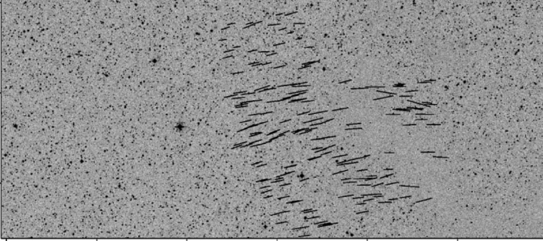
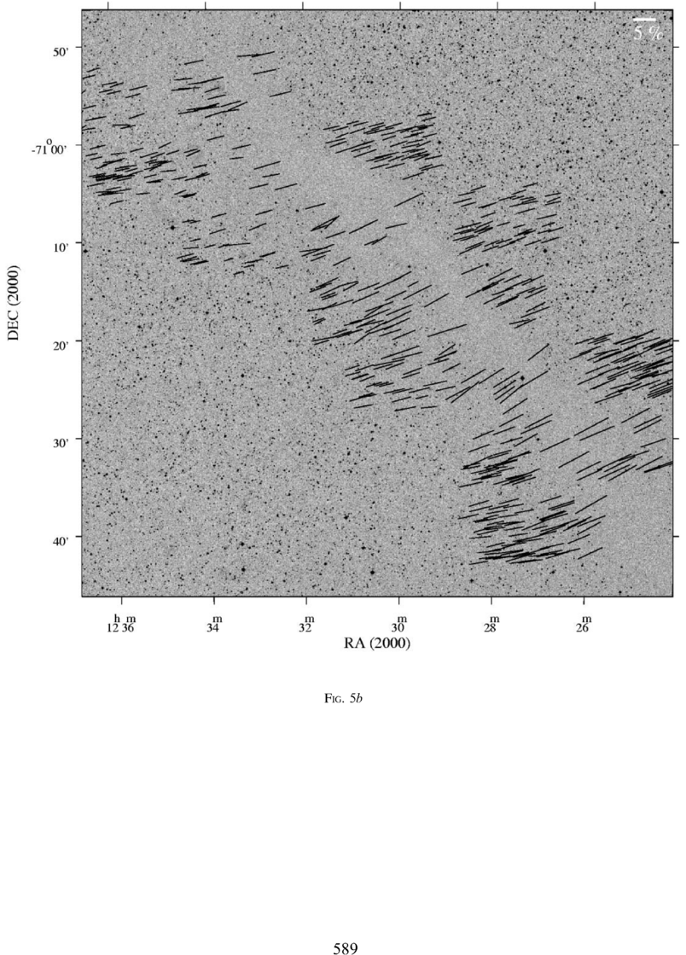
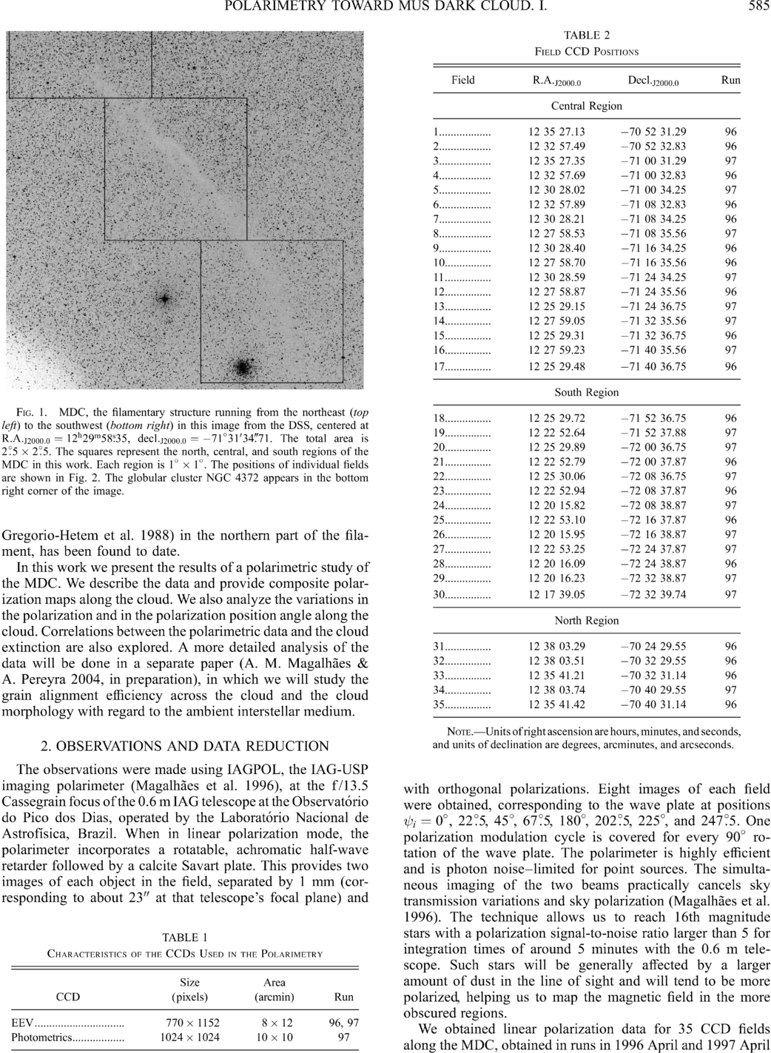
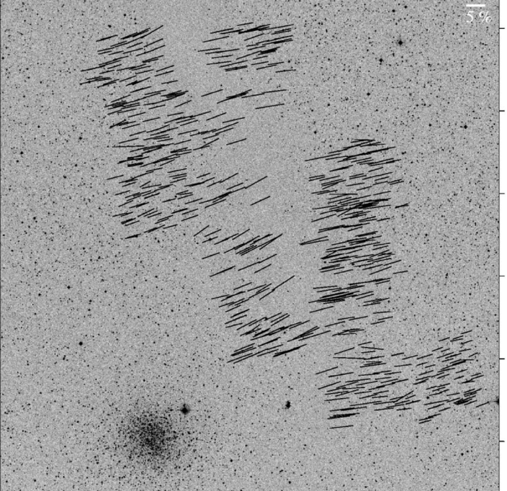
Large-scale: ordered fields
Musca dark cloud
10 pc
E,B
Pereyra & Magalhães 2004
Notes:
-Distance: 250 pc
-Mass: 250 solar masses
-Length ~10 pc

Slide 6
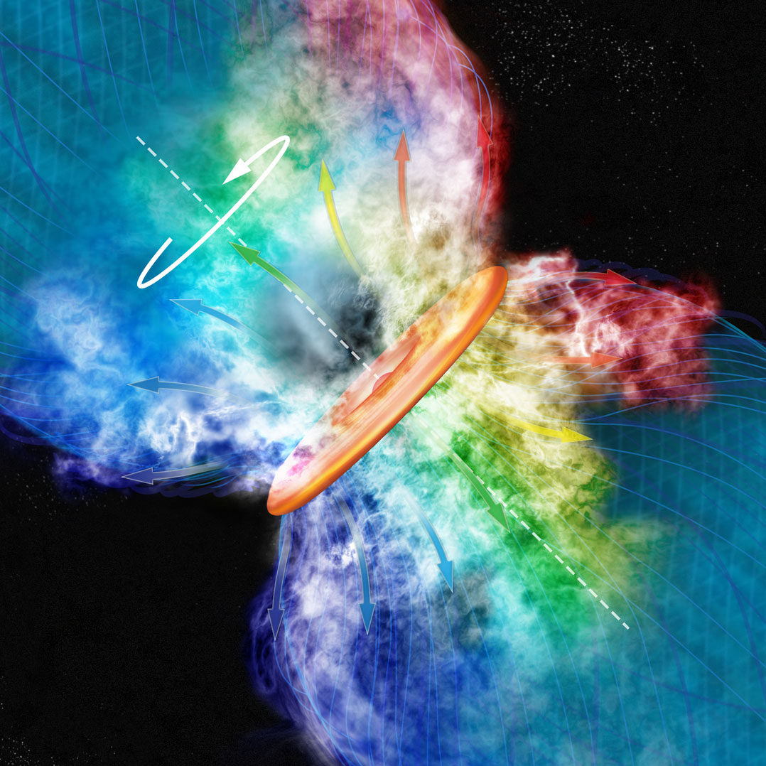
Credit: Bill Saxton, CfA

Slide 7
Outline
Magnetized star formation
B-fields vs. outflows: multi-scale comparisons
Outflows/jets/disks and B-fields are randomly aligned
TADPOL survey
CARMA 1mm full-Stokes polarization system
TADPOL results
B-fields: multi-scale comparisons
Cloud → core → envelope → disk

Slide 8
Multi-scale comparisons: B-fields vs. outflows
1 pc
0.1 pc
1000 AU
100 AU
RANDOM
Ménard & Duchêne 2004
Targon+ 2011

Slide 9
Misalignment of B-fields and disks/jets
Comparing orientations of large-scale B-field with disks/jets in T Tauri stars
Ménard & Duchêne 2004
CDF
Angle between jet & B-field (deg)
10 pc

Slide 10
Misalignment of B-fields and disks/jets
CDF
~1 pc
Targon+ 2011
Angle between optical jet & ambient B-field (deg)

Slide 11
Multi-scale comparisons: B-fields vs. outflows
1 pc
0.1 pc
1000 AU
100 AU
RANDOM
Ménard & Duchêne 2004
Targon+ 2011

Slide 12
Multi-scale comparisons: B-fields vs. outflows
1 pc
0.1 pc
1000 AU
100 AU
RANDOM
Curran & Chrysostomou 2007

Slide 13
Misalignment of B-fields and outflows
Comparing B-fields with outflows on the core (~0.1 pc) scale
B
CDF
~0.25 pc
Curran & Chrysostomou 2007
Angle between outflow & B-field (deg)

Slide 14
Multi-scale comparisons: B-fields vs. outflows
1 pc
0.1 pc
1000 AU
100 AU
RANDOM
Curran & Chrysostomou 2007

Slide 15
Multi-scale comparisons: B-fields vs. outflows
1 pc
0.1 pc
1000 AU
100 AU
RANDOM
Hull+ 2013

Slide 16
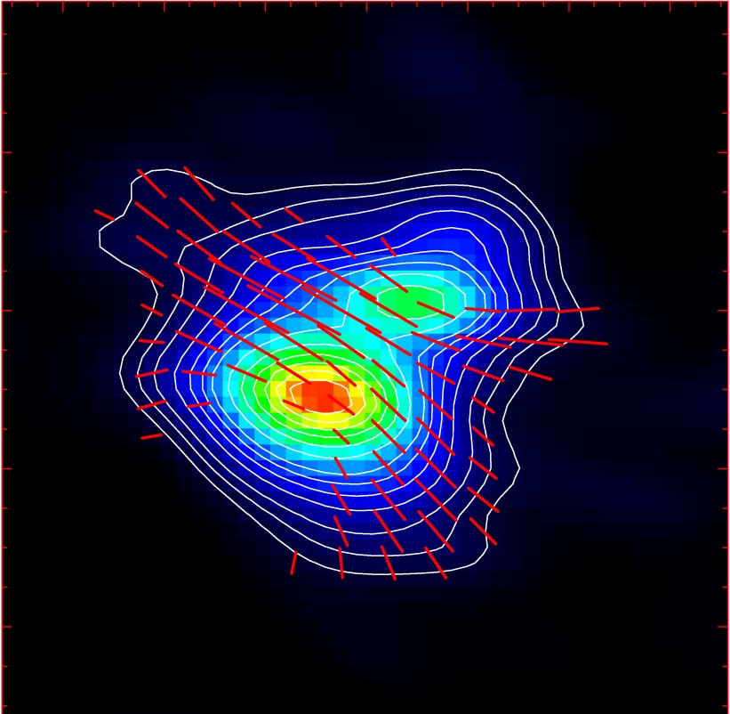
Misalignment of B-fields and outflows
IRAS 16293
NGC 1333-IRAS 4A
B-field
Rao+ 2009
Girart+ 2006
Outflow
Notes:
ROTATION: IRAS 16293 has rot/grav < 0.1; IRAS4A seems the same (barely any rotation); VLA 1623 questionable (probably slow)
-Holland: JCMT data
-Rao, Girart: SMA
-This is okay, according to Hennebelle & Ciardi ‘09 (easier to form disks with obliquity!)
-Ward-Thompson et al (2009) saw a 30 deg offset between short axes of cores and their polarization directions…another problem!

Slide 17
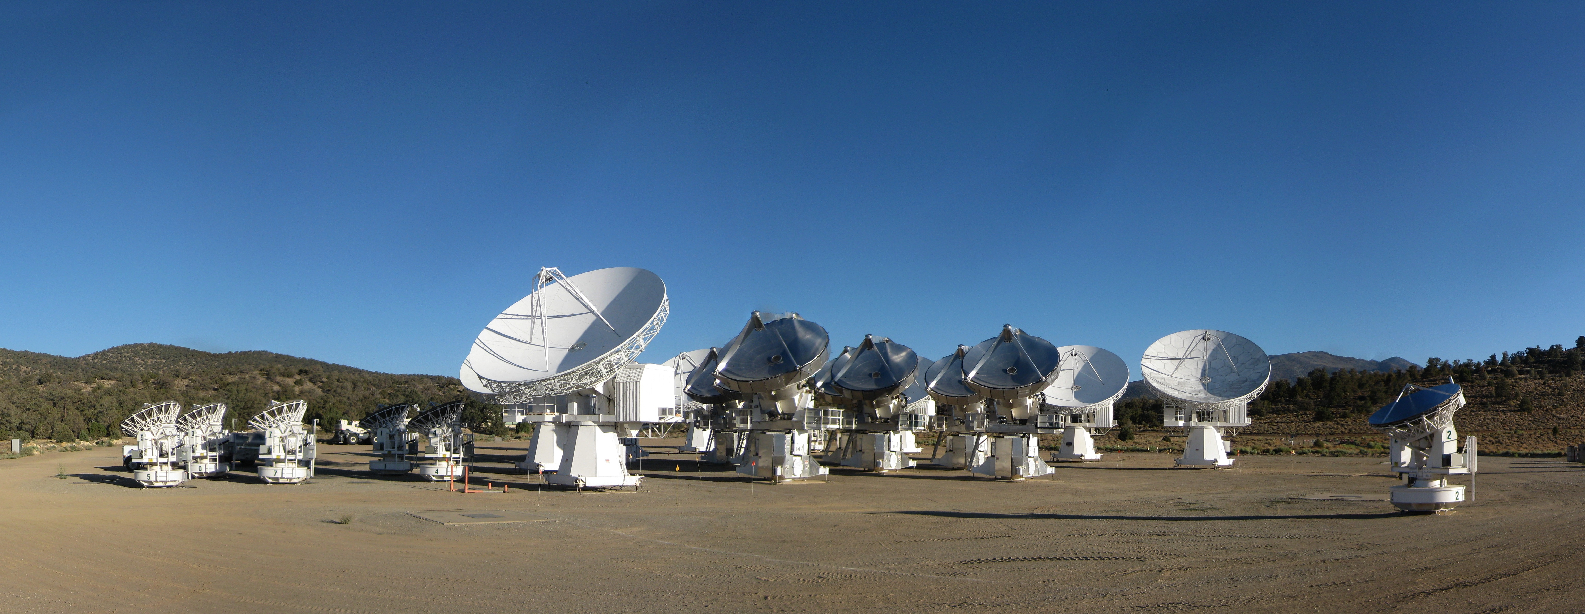
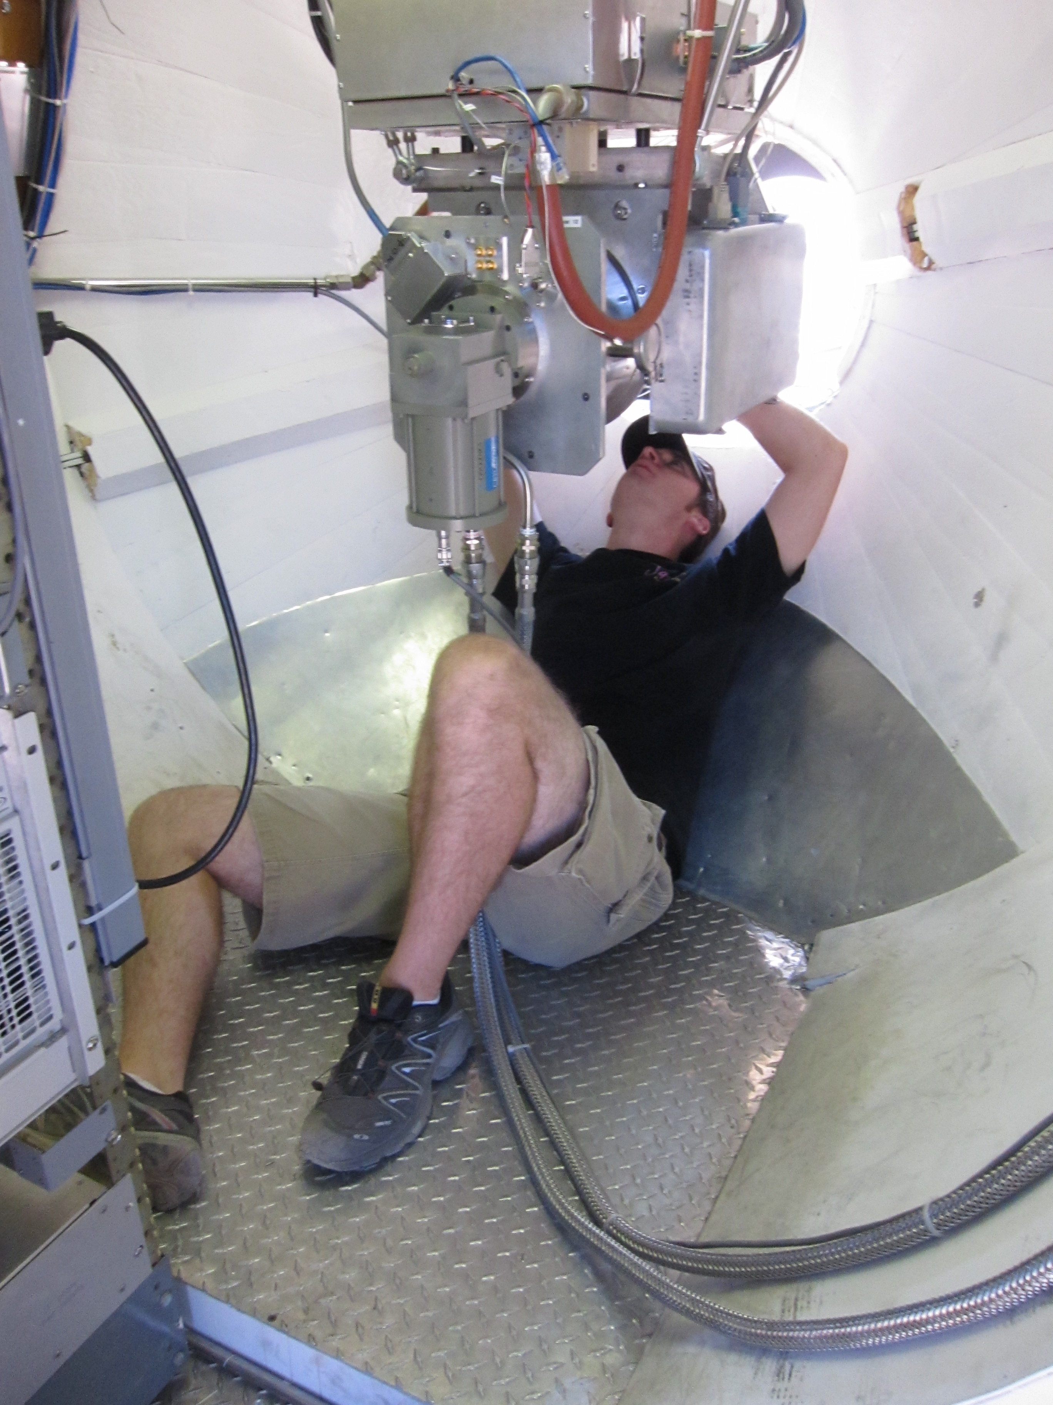
CARMA Combined Array for Research in Millimeter-wave Astronomy Consortium: Berkeley, Caltech, Illinois, Maryland, Chicago
6 ⨯10-m, 9 ⨯ 6-m, 8 ⨯ 3.5-m telescopes
Observations at 1 cm, 3 mm, and 1 mm (polarization!)
Located in Cedar Flat, CA (near Bishop)
Notes:
SMA: 8*6m antennas = 226 m^2
CARMA: 6*10m, 9*6m = 726 m^2 (more than factor of 3 more area)
-Factor of two more dishes
-Equivalent T_sys?

Slide 18
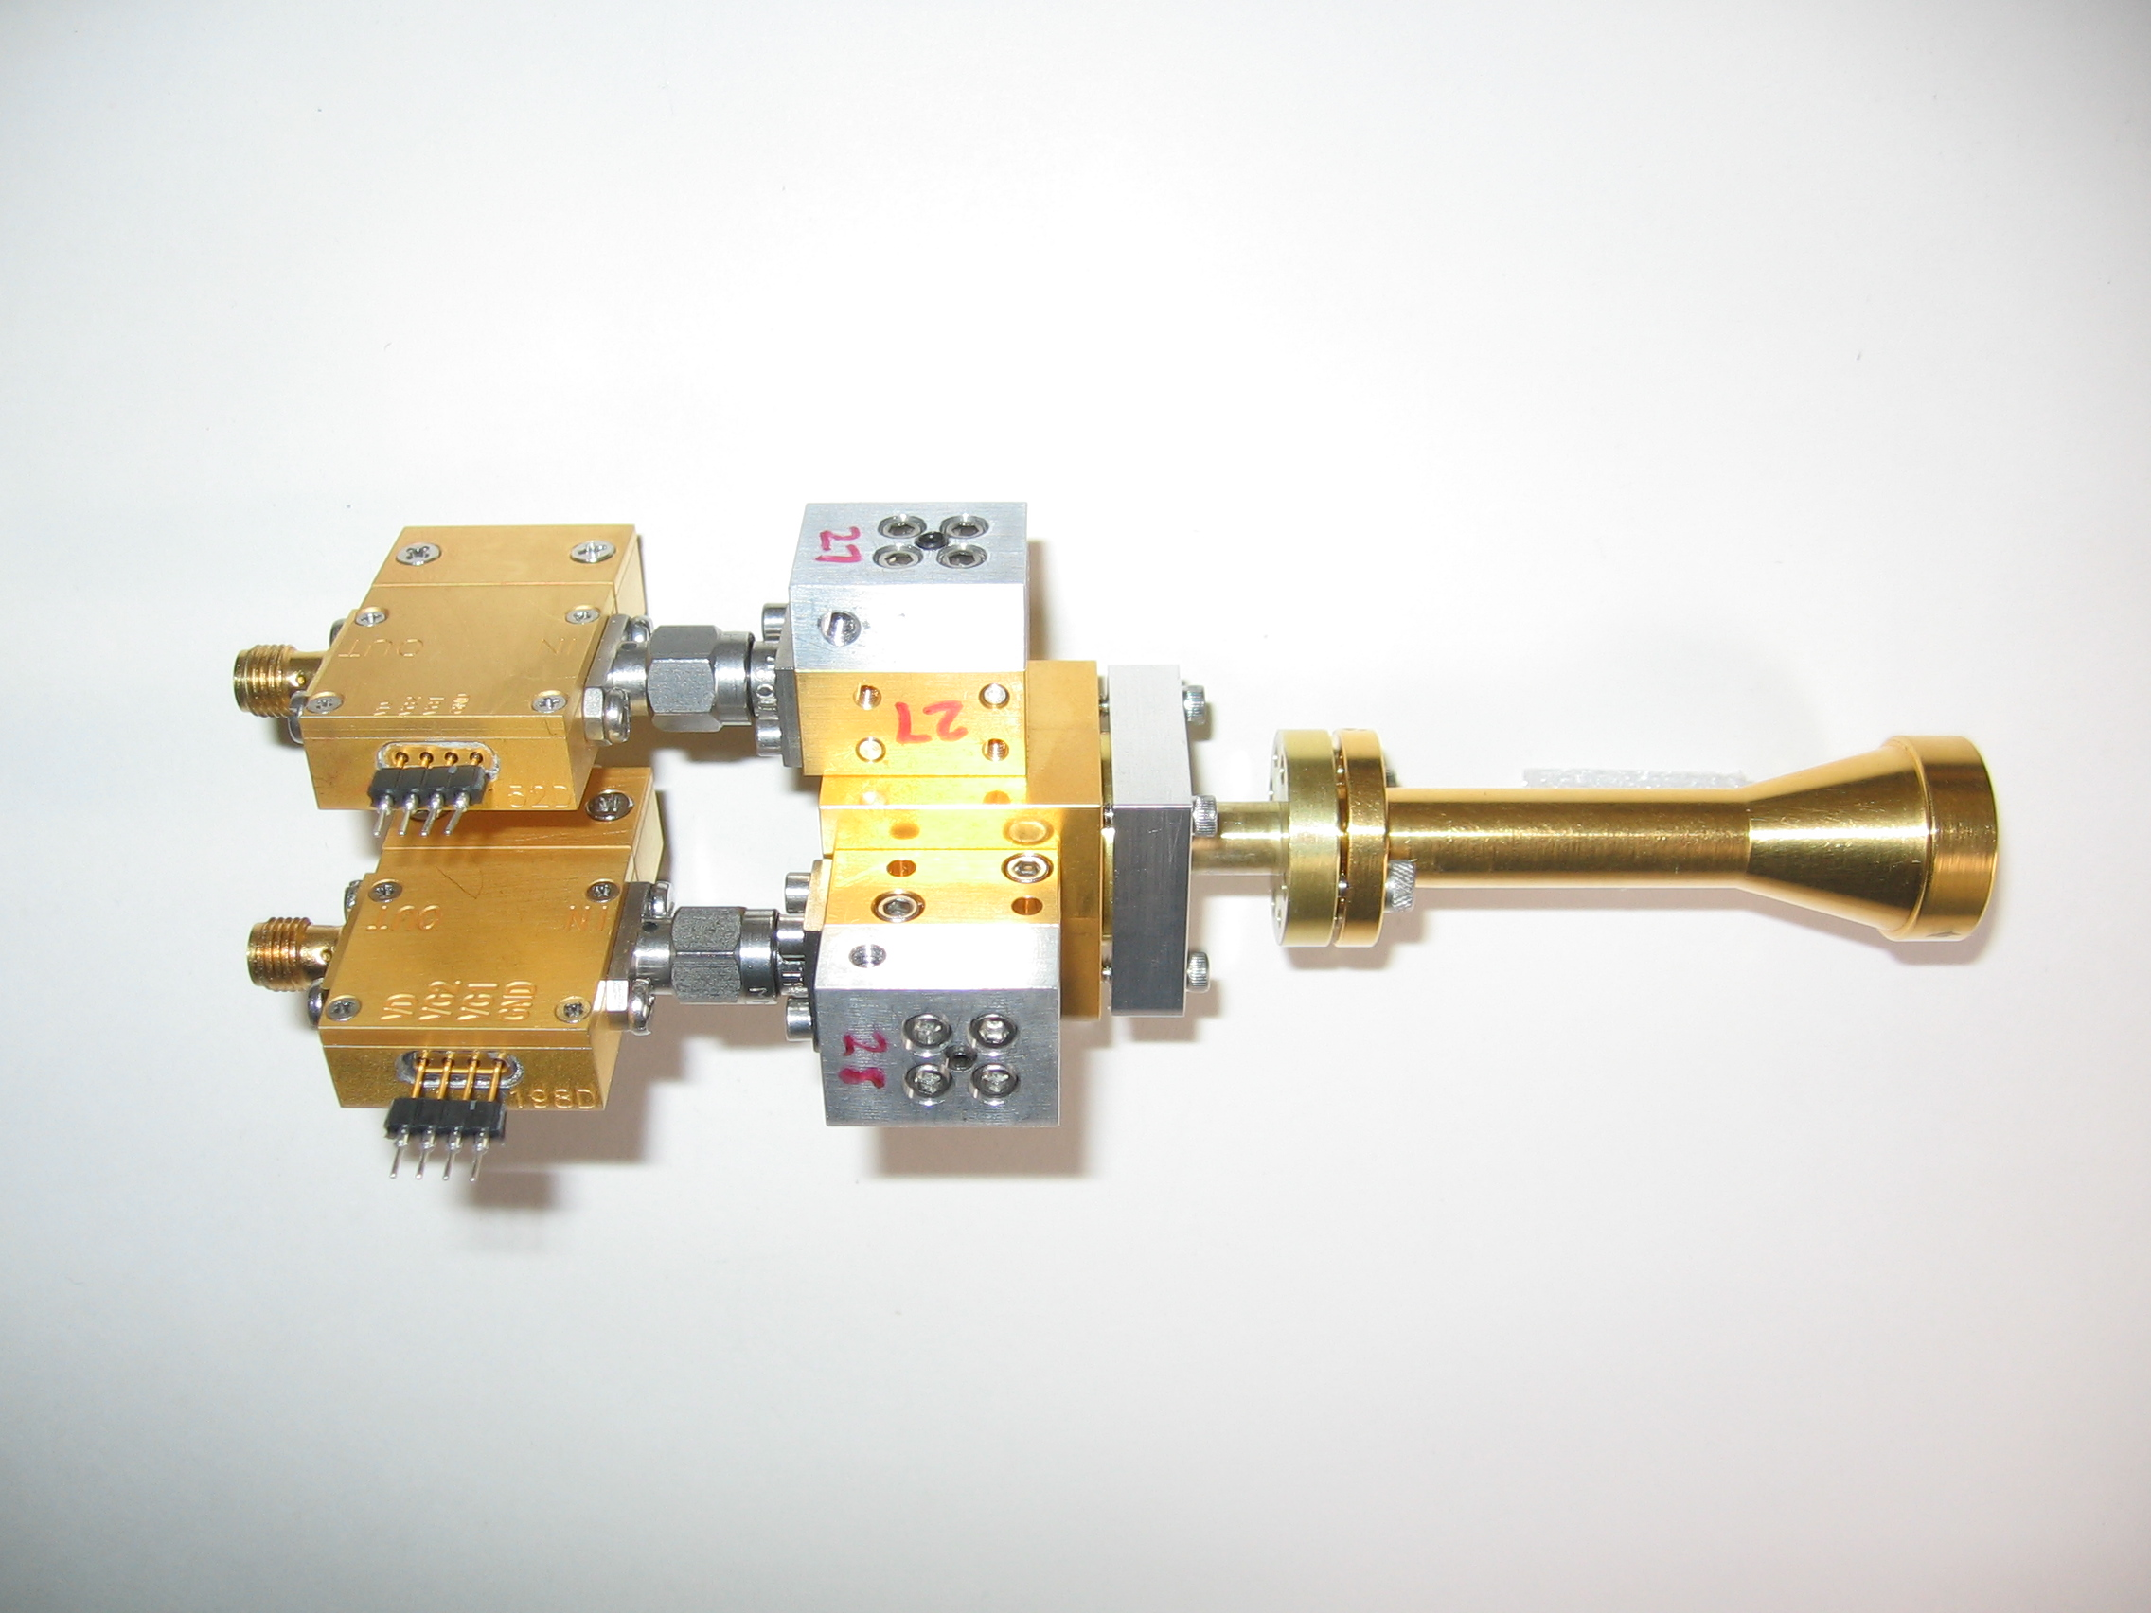
1 mm dual-polarization receivers
SIS mixers
Orthomode transducer
Waveguide circular polarizer
1 inch
WBA13
I.F. amplifiers (1-9 GHz)
Credit: Dick Plambeck
Notes:
-Sensitive to RCP & LCP
-Null experiment: in the absence of linear polarization, you get no RL correlation at any time.
-If you have linear feeds, you have XY correlation sometimes (when the intrinsic polarization is at 45º to your two feeds), and not other times (when it’s along one feed or the other). Thus, to tease out the polarization, you need stable gains

Slide 19
1 mm dual-polarization receivers
Waveguide circular polarizer
1 inch
Credit: Dick Plambeck
Notes:
-Sensitive to RCP & LCP
-Null experiment: in the absence of linear polarization, you get no RL correlation at any time.
-If you have linear feeds, you have XY correlation sometimes (when the intrinsic polarization is at 45º to your two feeds), and not other times (when it’s along one feed or the other). Thus, to tease out the polarization, you need stable gains

Slide 20
2-section polarizer
λ/2 retarder
at 15°
λ/4 retarder
at 74.5°
Plambeck & Engargiola, CARMA Memo #54
Notes:
-Chose waveguide design because it can be integrated into the receiver (in the cold part), and thus doesn’t create loss the way a room-temperature quarter-wave plate does.

Slide 21
R L → → →
Polarizer simulation
← Feed horn (sky)
OMT →
Sky
Receiver
Plambeck & Engargiola, CARMA Memo #54
RCP
X
LCP
Y
Credit: Greg Engargiola
Y
X
Notes:
These are effectively quarter-wave plates.

Slide 22
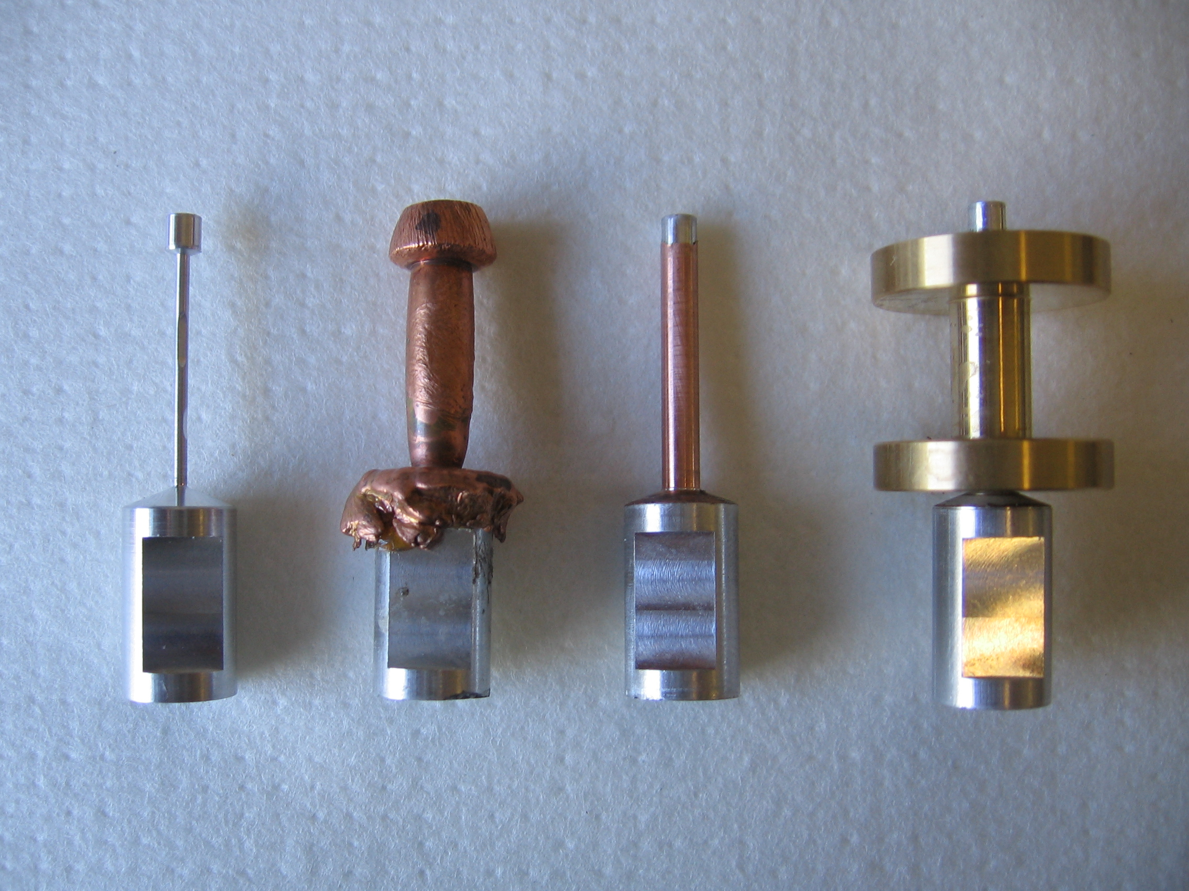
Polarizer construction
Aluminum
mandrel
Copper electroplated onto mandrel
Machined
Soldered into waveguide flange
1 inch

Slide 23
Misalignment of B-fields and outflows
IRAS 16293
NGC 1333-IRAS 4A
B-field
Rao+ 2009
Girart+ 2006
Outflow
Notes:
ROTATION: IRAS 16293 has rot/grav < 0.1; IRAS4A seems the same (barely any rotation); VLA 1623 questionable (probably slow)
-Holland: JCMT data
-Rao, Girart: SMA
-This is okay, according to Hennebelle & Ciardi ‘09 (easier to form disks with obliquity!)
-Ward-Thompson et al (2009) saw a 30 deg offset between short axes of cores and their polarization directions…another problem!

Slide 24
TADPOL survey

Slide 25
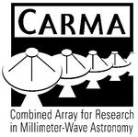












TADPOL collaboration
UC Berkeley
Chat Hull (PI), Dick Plambeck, Mel Wright, Carl Heiles, Geoff Bower
University of Maryland
Marc Pound, Alberto Bolatto, Katherine Jameson,
Lee Mundy
Caltech
Thushara Pillai, John Carpenter, James Lamb,
Nikolaus Volgenau
University of Illinois, Urbana-Champagne
Ian Stephens, Leslie Looney, Woojin Kwon,
Dick Crutcher, Nick Hakobian
Other
Dan Marrone (Arizona), Meredith Hughes (Wesleyan), John Vaillancourt & Göran Sandell (USRA-SOFIA), John Tobin (NRAO), Jason Fiege (Manitoba),
Erica Franzmann (Manitoba), Martin Houde (UWO, Caltech), Brenda Matthews (NRC-CNRC)

Slide 26
TADPOL survey
37 sources
Triples number of interferometric polarization maps
~300 observing hours
CARMA C, D, & E arrays
1 – 4" resolution
10⨉ higher resolution than CSO & JCMT
Probes intermediate region between ~0.1 pc (single-dish)
and ~100 AU (ALMA)

Slide 27
TADPOL results
L1157
2″
See also: Stephens+ 2013, ApJL, 769, L15
Notes:
NEARBY SF regions:
-Perseus (NGC 1333, L1448, SVS13): 235 pc (masers in SVS13) → 03:30 LST
-Taurus (DG Tau, L1527): 140 pc → 04:30 LST
-Orion: 400 pc → 05:30 LST
-Serpens: 415 pc → 18:30 LST
-Ophiuchus: 140 pc → 17:00 LST
-Cepheus (L1157): 250 pc → 22:00 LST
-Isolated (B335, Bok globule): 250 pc

Slide 28
Credit: Bill Saxton, CfA

Slide 29
TADPOL results
NGC 1333-IRAS 4A
NGC 1333-IRAS 4B
2″
2″
Notes:
NEARBY SF regions:
-Perseus (NGC 1333, L1448, SVS13): 235 pc (masers in SVS13) → 03:30 LST
-Taurus (DG Tau, L1527): 140 pc → 04:30 LST
-Orion: 400 pc → 05:30 LST
-Serpens: 415 pc → 18:30 LST
-Ophiuchus: 140 pc → 17:00 LST
-Cepheus (L1157): 250 pc → 22:00 LST
-Isolated (B335, Bok globule): 250 pc

Slide 30
TADPOL results
L1527
NGC 1333-IRAS 2A
2″
3″
Notes:
NEARBY SF regions:
-Perseus (NGC 1333, L1448, SVS13): 235 pc (masers in SVS13) → 03:30 LST
-Taurus (DG Tau, L1527): 140 pc → 04:30 LST
-Orion: 400 pc → 05:30 LST
-Serpens: 415 pc → 18:30 LST
-Ophiuchus: 140 pc → 17:00 LST
-Cepheus (L1157): 250 pc → 22:00 LST
-Isolated (B335, Bok globule): 250 pc

Slide 31
TADPOL results
Ser-emb 8
3″
Notes:
NEARBY SF regions:
-Perseus (NGC 1333, L1448, SVS13): 235 pc (masers in SVS13) → 03:30 LST
-Taurus (DG Tau, L1527): 140 pc → 04:30 LST
-Orion: 400 pc → 05:30 LST
-Serpens: 415 pc → 18:30 LST
-Ophiuchus: 140 pc → 17:00 LST
-Cepheus (L1157): 250 pc → 22:00 LST
-Isolated (B335, Bok globule): 250 pc

Slide 32
Outflow vs. B-field: distribution
Simulation: outflows & B-fields aligned within a 20º cone (tightly aligned)
Simulation: outflows & B-fields are randomly oriented
Cumulative Distribution Function (CDF)
Simulation: outflows & B-fields aligned between 70–90º (preferentially misaligned)
KS-test results:
20º cone ruled out ( p-value ~ 10⁻¹⁵ )
Misaligned ( 0.33 ) and random ( 0.33 ) cannot be ruled out
Hull+ 2013, ApJ, 768, 159
(updated version: July ‘13)
(Projected) angle between outflow & B-field (deg)

Slide 33
Outline
Magnetized star formation
B-fields vs. outflows: multi-scale comparisons
Outflows/jets/disks and B-fields are randomly aligned
TADPOL survey
CARMA 1mm full-Stokes polarization system
TADPOL results
B-fields: multi-scale comparisons
Cloud → core → envelope → disk

Slide 34
Multi-scale comparisons: B-fields
> 1 pc
0.1 pc
1000 AU
100 AU
CONSISTENT
Hua-bai Li+ 2009

Slide 35
Large → medium scale Consistent B-field in clouds & cores
E,B
~0.3 pc
E
B
H.-b. Li+ 2009
Sub-mm CSO data
n ~ 10⁵ cm⁻³
L ~ 0.3 pc
Optical data
n ~ 1 cm⁻³
L ~ 100 pc
Notes:
Orion Molecular Cloud region
-Optical polarimetry data: blue vectors
-Huge grey vectors: average of all blue vectors
-IRAS data: just to guide the eye (background image)
-CSO data: dust emission
-White vectors: average of CSO dust polarization
-ALL orientations are B-field directions
-Comparing with simulations, they find that a super-Alfvénic cloud (more turbulence than magnetic support) doesn’t fit well

Slide 36
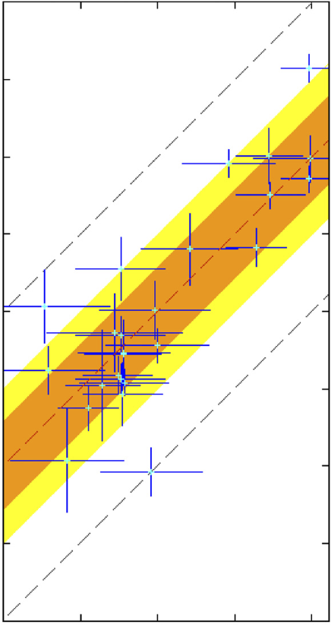
Large → medium scale: Consistent B-fields
B_{amb} (deg)
0
90
180
B_{core} (deg)
90
0
Li+ 2009
H.-b. Li+ 2009
-90
Notes:
Orion Molecular Cloud region
-Optical polarimetry data: blue vectors
-Huge grey vectors: average of all blue vectors
-IRAS data: just to guide the eye (background image)
-CSO data: dust emission
-White vectors: average of CSO dust polarization
-ALL orientations are B-field directions
-Comparing with simulations, they find that a super-Alfvénic cloud (more turbulence than magnetic support) doesn’t fit well

Slide 37
Multi-scale comparisons: B-fields
> 1 pc
0.1 pc
1000 AU
100 AU
CONSISTENT
Hua-bai Li+ 2009

Slide 38
Future multi-scale comparison: B-fields
1 pc
0.1 pc
1000 AU
100 AU
Consistent?
SCUBA/CSO +
CARMA/SMA

Slide 39
Future multi-scale comparison: B-fields
1 pc
0.1 pc
1000 AU
100 AU
CARMA/SMA +
ALMA

Slide 40
Summary
B-fields are either preferentially misaligned (perp.) or randomly aligned with respect to outflows at the ~1000 AU scale
Thus, circumstellar disks are misaligned with fields in the cores from which they formed
Questions:
Why are B-fields and outflows randomly aligned (turbulence?)
Will disk-scale B-field measurements unite the two tales?
Future work:
Compare B-fields at SCUBA → CARMA scales
Compare B-fields at CARMA → ALMA scales
Compare polarization in filaments with ALMA data
CARMA 1 mm polarization system is online and accepting proposals
TADPOL first results: ApJ, 768, 159
TADPOL survey (CARMA key project): tadpol.astro.illinois.edu
Notes:
Other TADPOL future possibilities:
Intrinsic modeling of B-fields in cores (Fiege)
Constraints on B-fields in protoplanetary disks (Hughes)
Turbulence power spectra (Houde)
Larger scale background-star maps (Mimir, Jameson/Pillai/Clemens)

Slide 41
Fin

